Slide 2
What Do You Know about Bullying?
Do you know anybody who has been bullied?
Have you ever been bullied?
Bullying is hurting someone on purpose, over and over again.
It can happen face to face with actions or with words or it can happen online through a phone, tablet or computer.

Slide 3
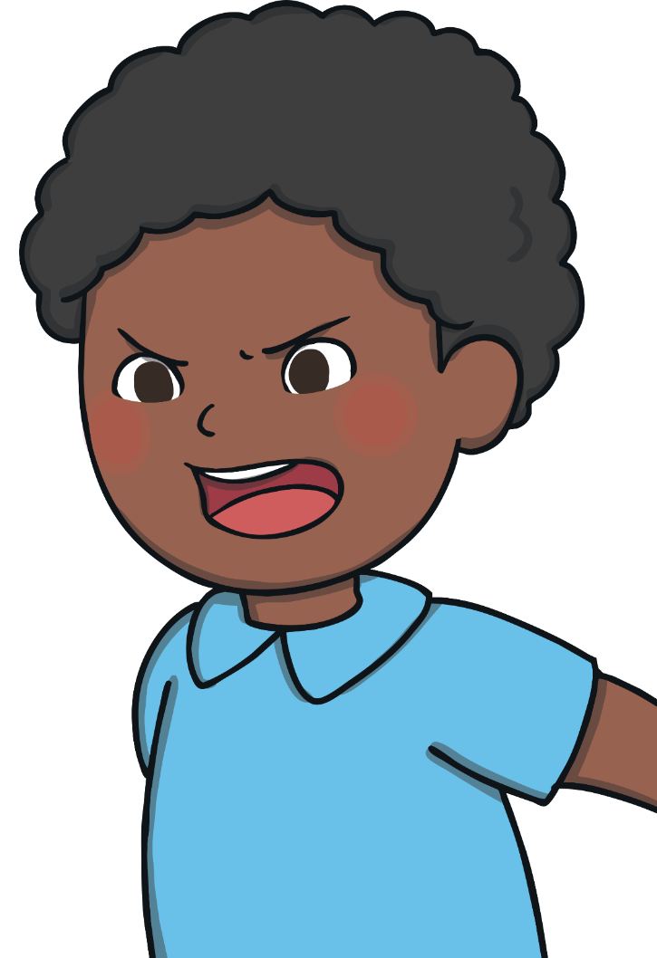
What Is Bullying?
Remember, bullying is hurting someone on purpose over and over again. It is not when an unkind thing happens only once.
Bullying can be shouting at or teasing another person.
Bullying can be saying unkind things to somebody or whispering unkind things about somebody else.
Bullying can be saying unkind things about someone’s body.
Bullying can be saying unkind things about how somebody looks, what they are wearing or what they are doing.
Bullying can be saying somebody can’t join in.

Slide 4
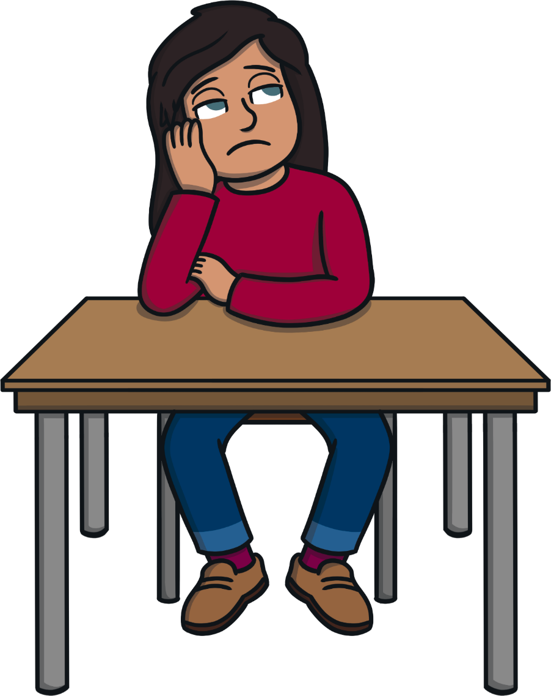
Why Does Bullying Happen?
Bullying sometimes happens because we are all different.
Bullies might be jealous of someone else’s talents.
Bullies might be jealous of other friendships.
Bullies might feel angry or bad about themselves.
Bullies might have been bullied or might not understand what bullying is.

Slide 5
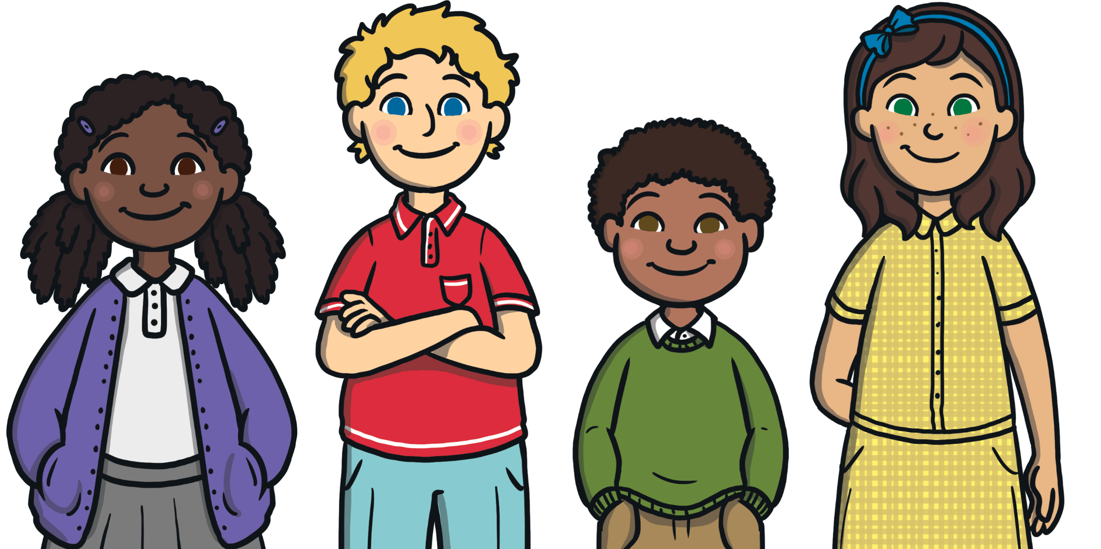
What Is Anti-Bullying Week?
It is an annual event that is held every November in the UK.
It aims to raise awareness of bullying, what it looks like and how we can help to stop it happening.

Slide 6
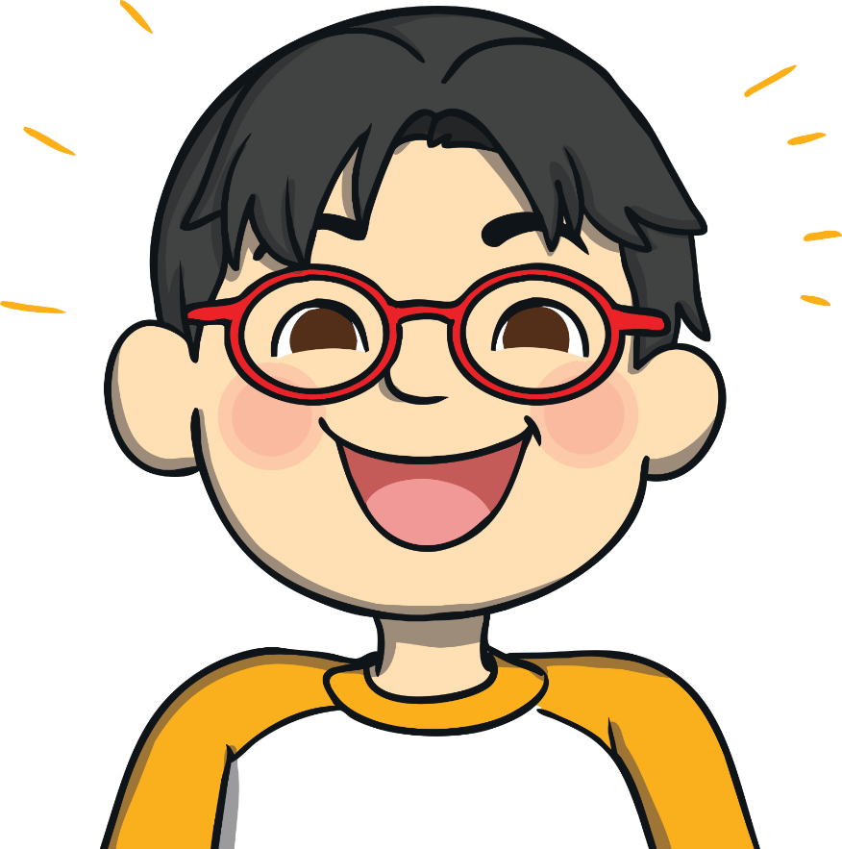
Anti-Bullying Week 2021
In 2021, Anti-Bullying Week begins on Monday 15th until Friday 19th November. The week will begin with Odd Socks Day.
The theme this year is One Kind Word
Kindness is more important today than it has ever been before. The isolation of the last year has made us more aware of how little acts of kindness can brighten the lives of the people around us.
Remember: Small actions make a huge impact. Ask someone if they’re OK. Say you’re sorry. Say hello!

Slide 7
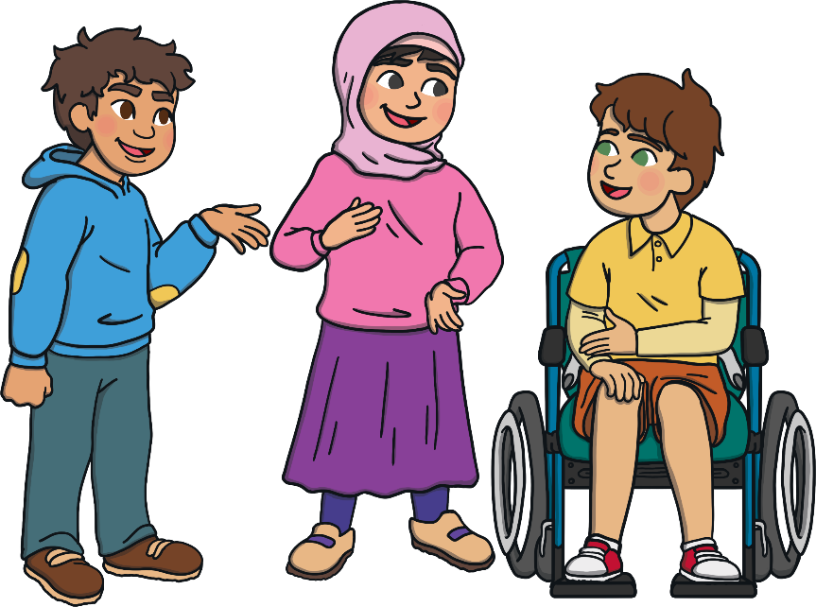
One Kind Word
One kind word can give a moment of hope. Something so small can change someone’s thoughts from bad to good. It can change their day and help to end bullying.
One kind word leads to another kind word. Kindness spreads and we can create a chain of kindness.
What kind word could you pass on today?

Slide 8
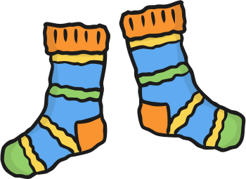
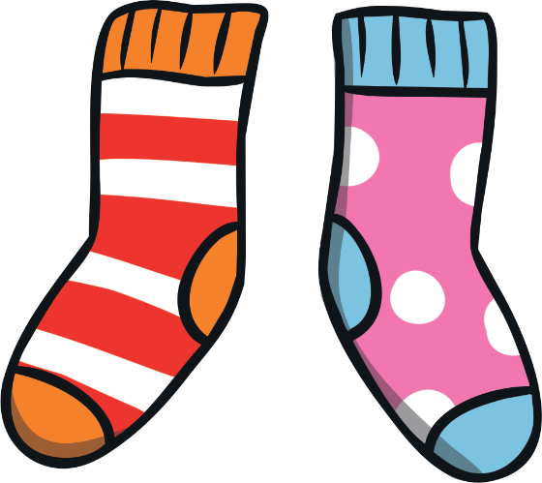
Odd Socks Day
Anti-Bullying Week starts with Odd Socks Day.
This is to celebrate how we are all different.
Let’s be kind to each other and love how we are all different.

Slide 9
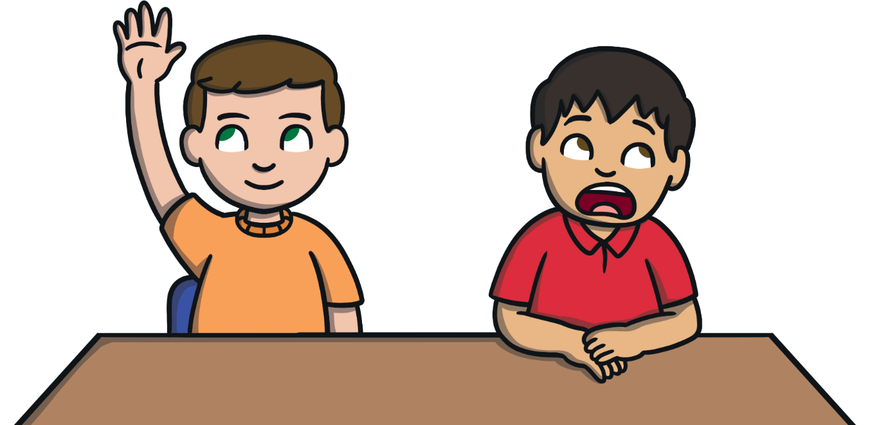
We Are All Different
We are different for lots of different reasons.
eye colour
skin colour
hair colour
family
what we find tricky to do
body shape
likes and dislikes
Can you think of any more?

Slide 10
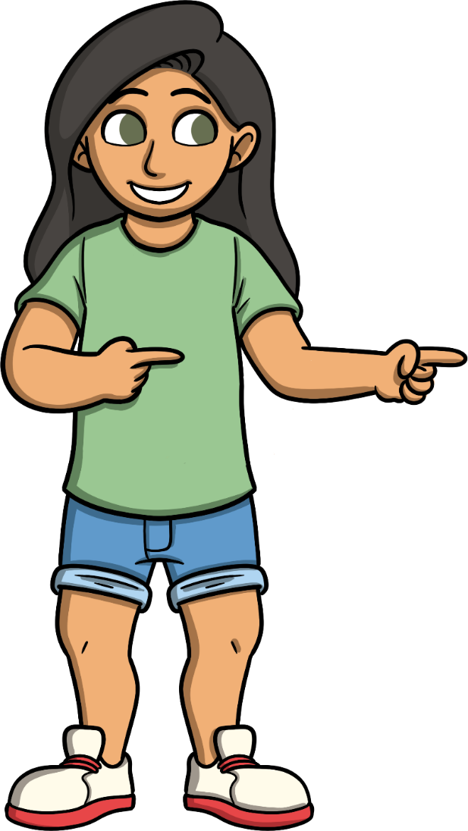
What Should You Do If You Are Being Bullied?
Tell someone!
Someone can always help. Find a trusted adult and ask them to help you.
Even if it’s not you being bullied, help other people around you. Ask if they are OK or if they need something.

Slide 11
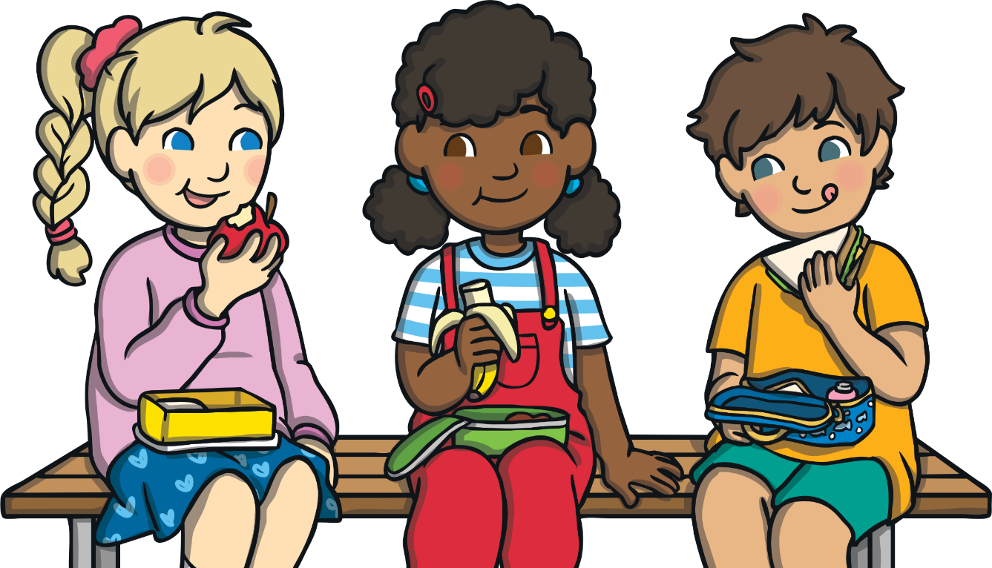
True or False?
You can tell somebody is a bully just by looking at them.
If you are a bully, you will always be a bully.
Bullies make people feel upset.
Nobody should be bullied because they are different.
false
false
true
true

